Slide 1
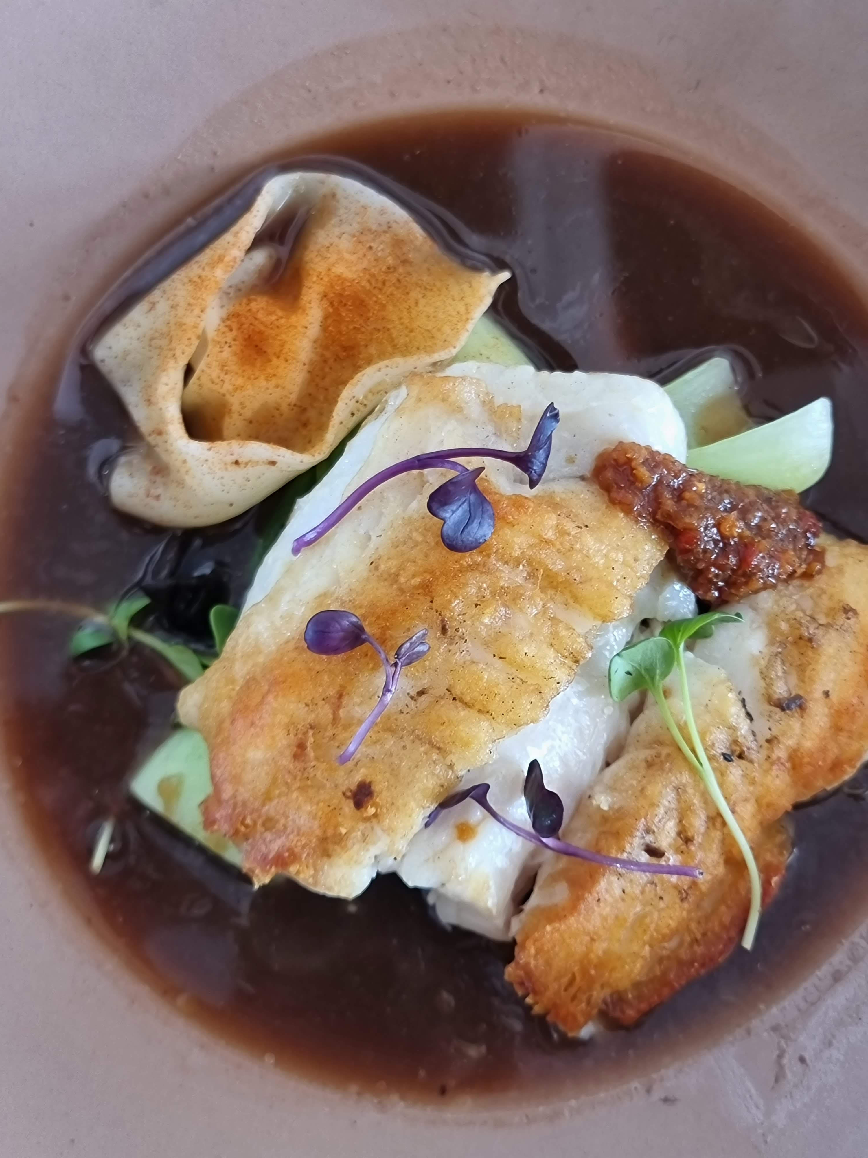
dishes
That
sell
TOURISM CENTRAL OTAGO

Slide 2
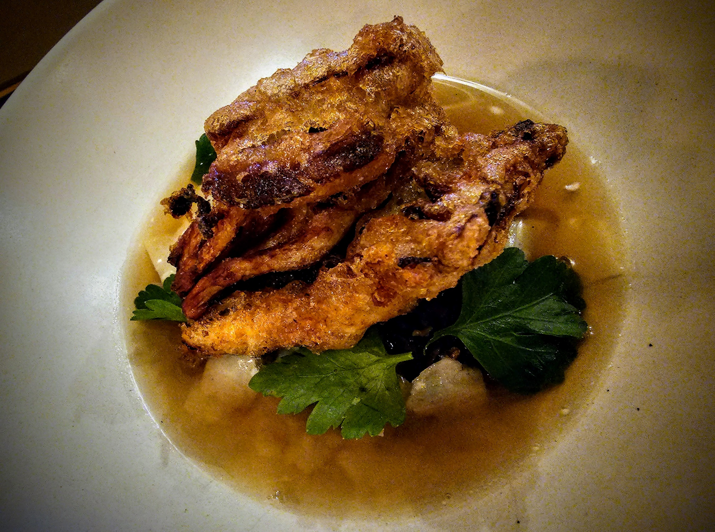
What was the last great dish you ate? And why was it so good?

Slide 3
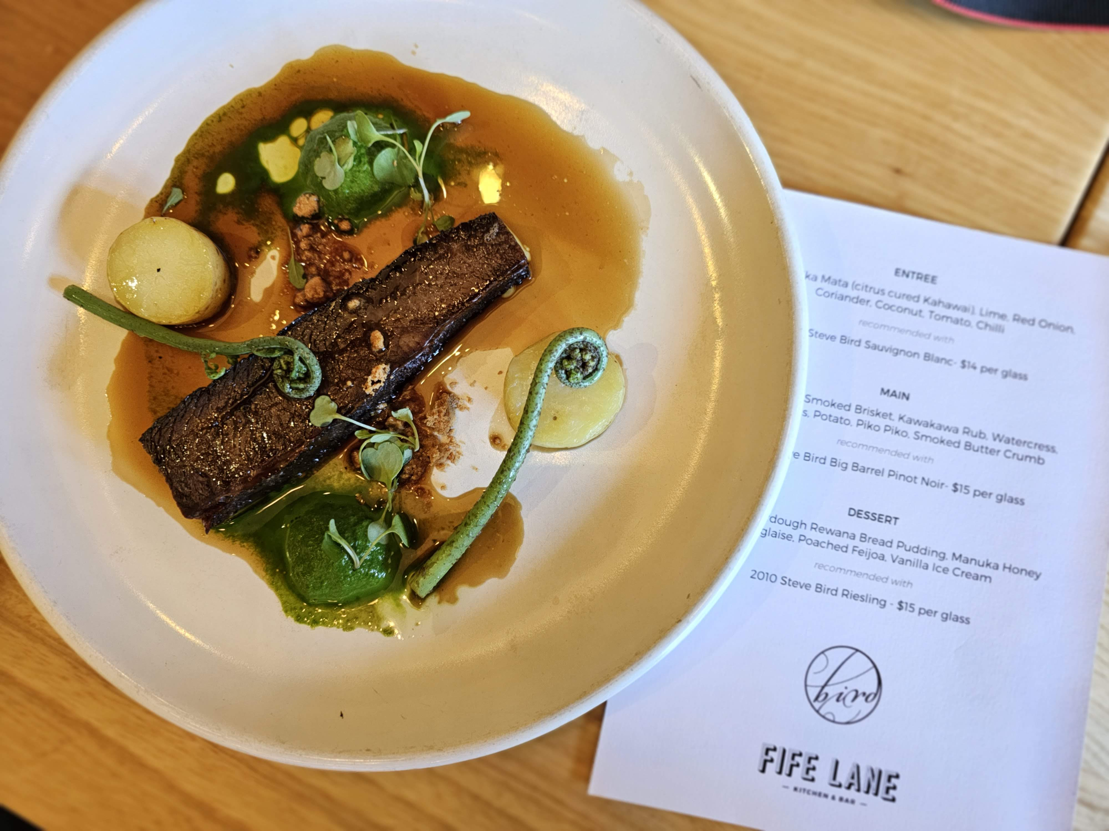
How is a festival or limited time dish different from a regular dish?

Slide 4
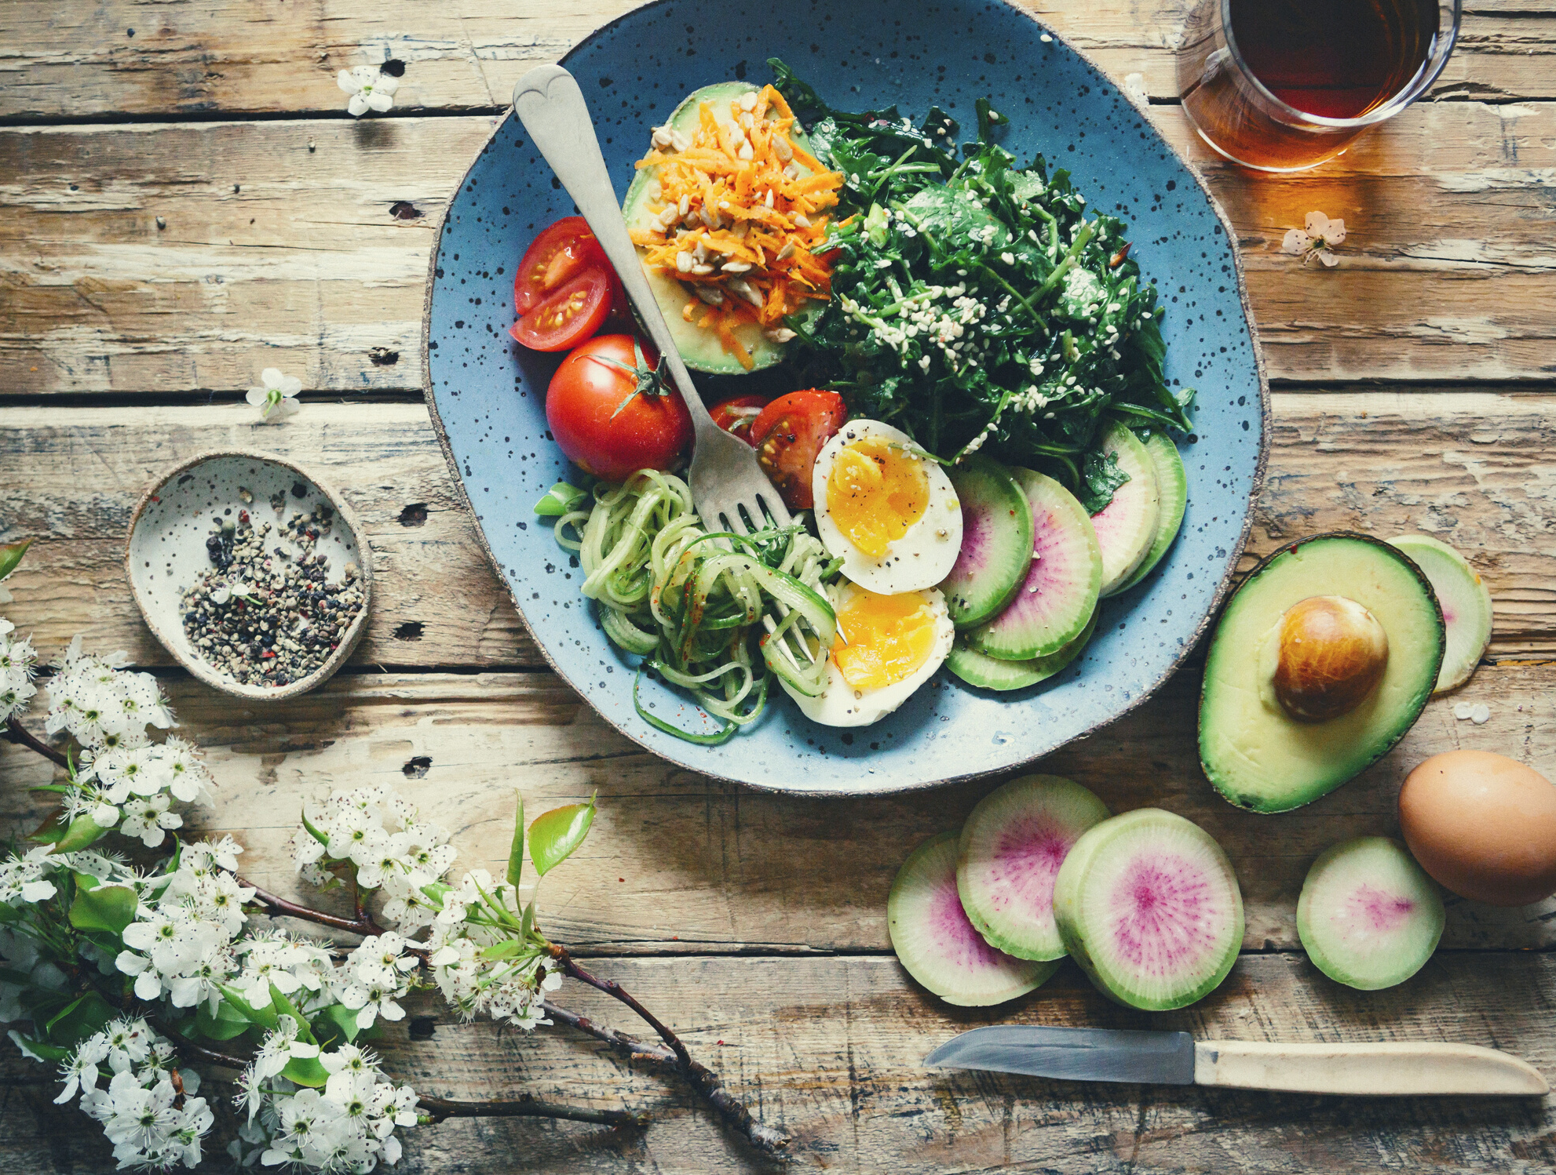
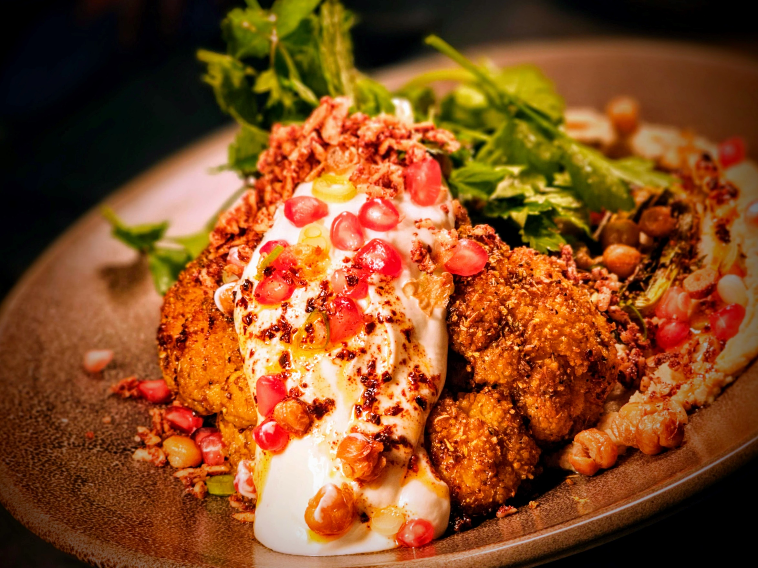
How can we have fun or be creative with ETC dishes?

Slide 5
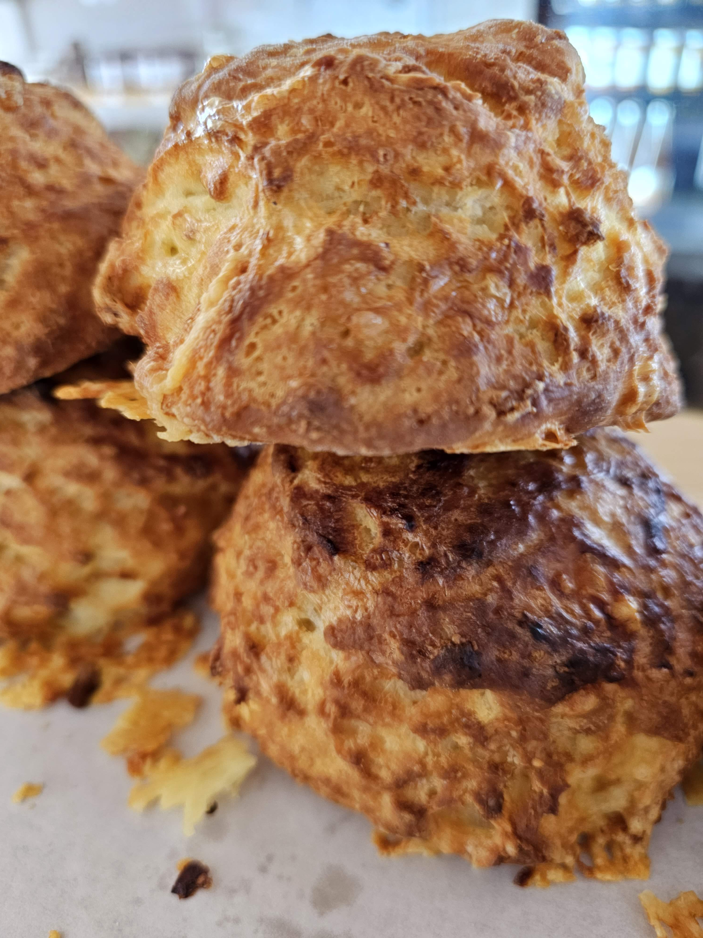
Tell a story
Who created it? How did it come about? What’s it’s history? What was the inspiration – grandma’s recipe, a migrant family you met? Something from your travels? The history of Central Otago?

Slide 6
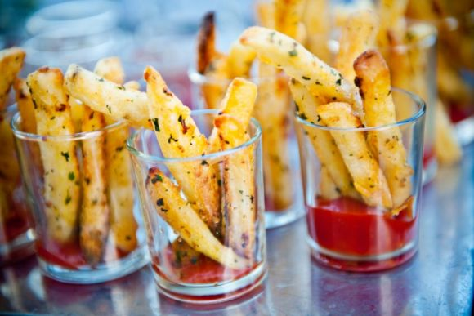
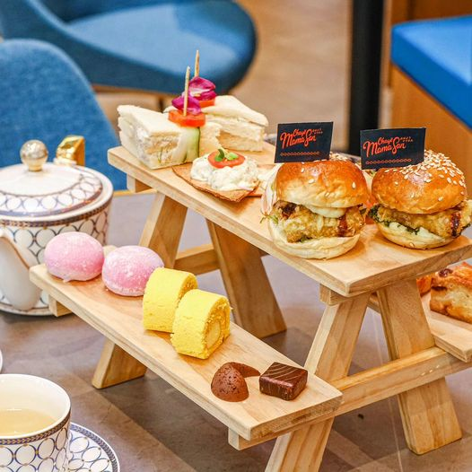
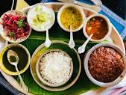
Have fun with presentation

Slide 7
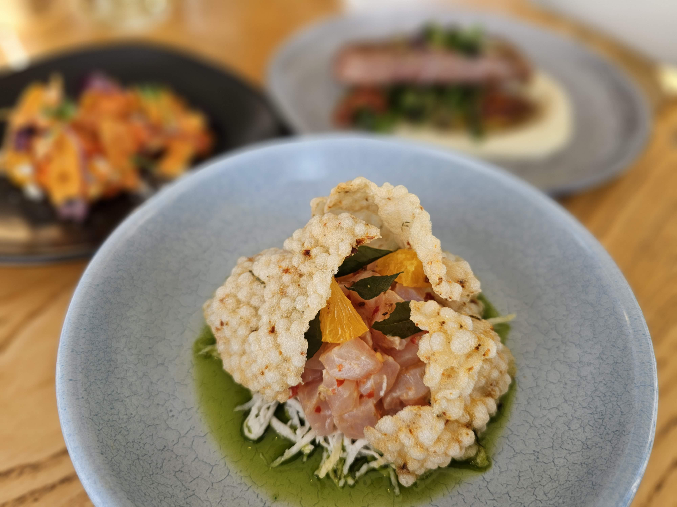

Slide 8
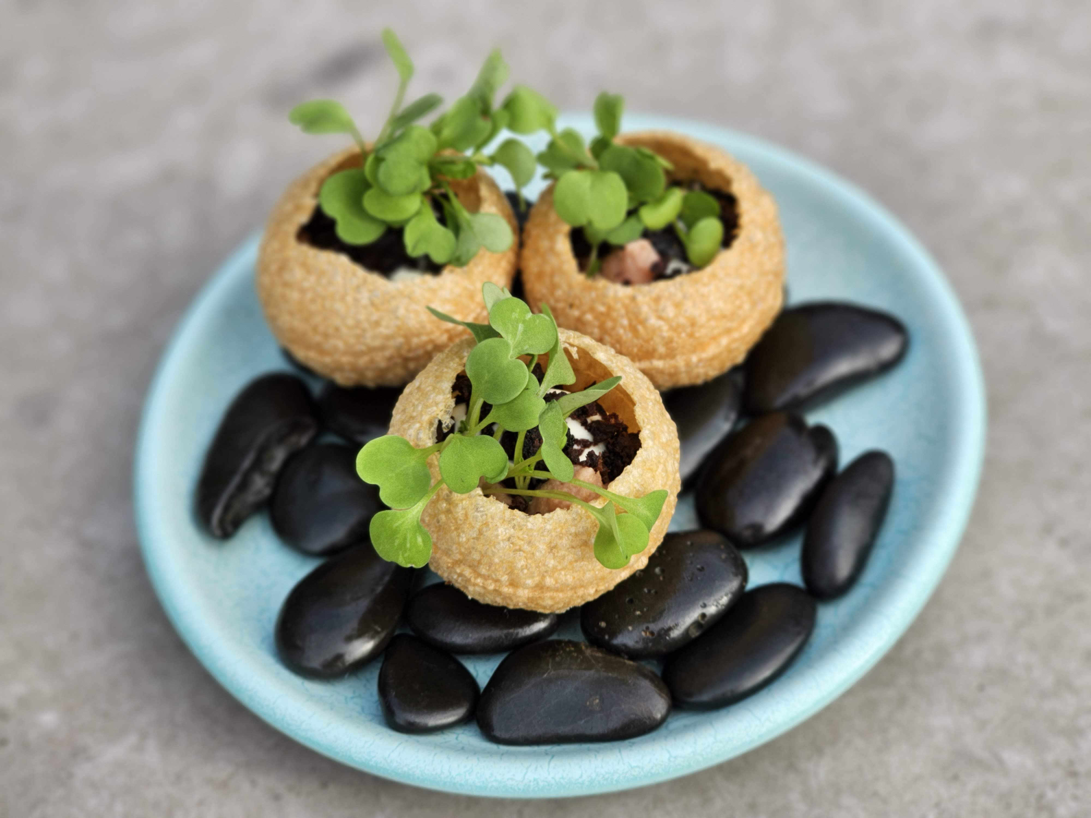

Slide 9
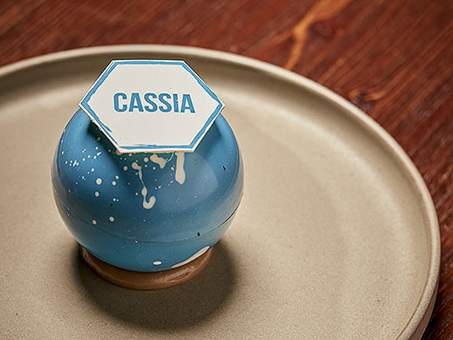

Slide 10
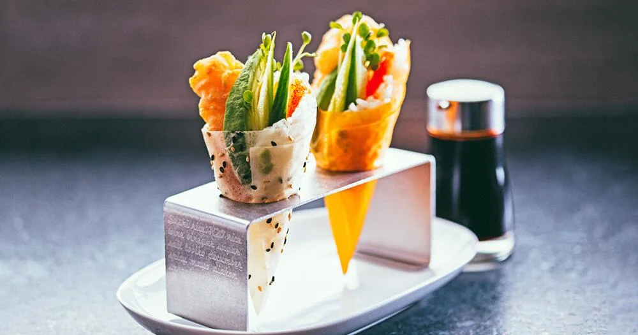
Bento box
Thali
High tea stand
Paper cone
Board
Something interactive/DIY aspect – mix up your own perfect sauce
Greatest hits platter/deconstructed meals
Different format - cheeseburger becomes a cheeseburger dumpling
Peking duck styles
Presentation
inspiration

Slide 11
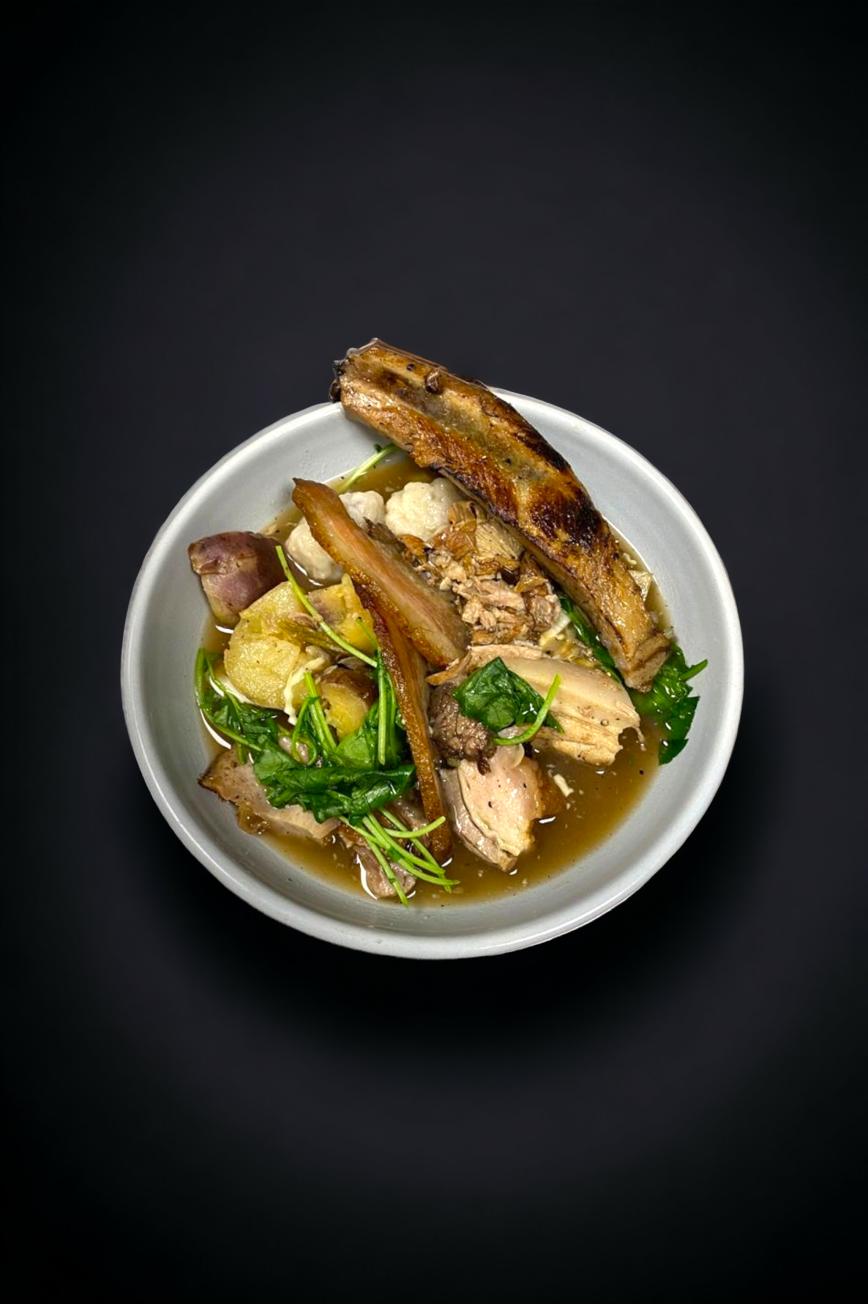
Do something really different to your normal menu

Slide 12
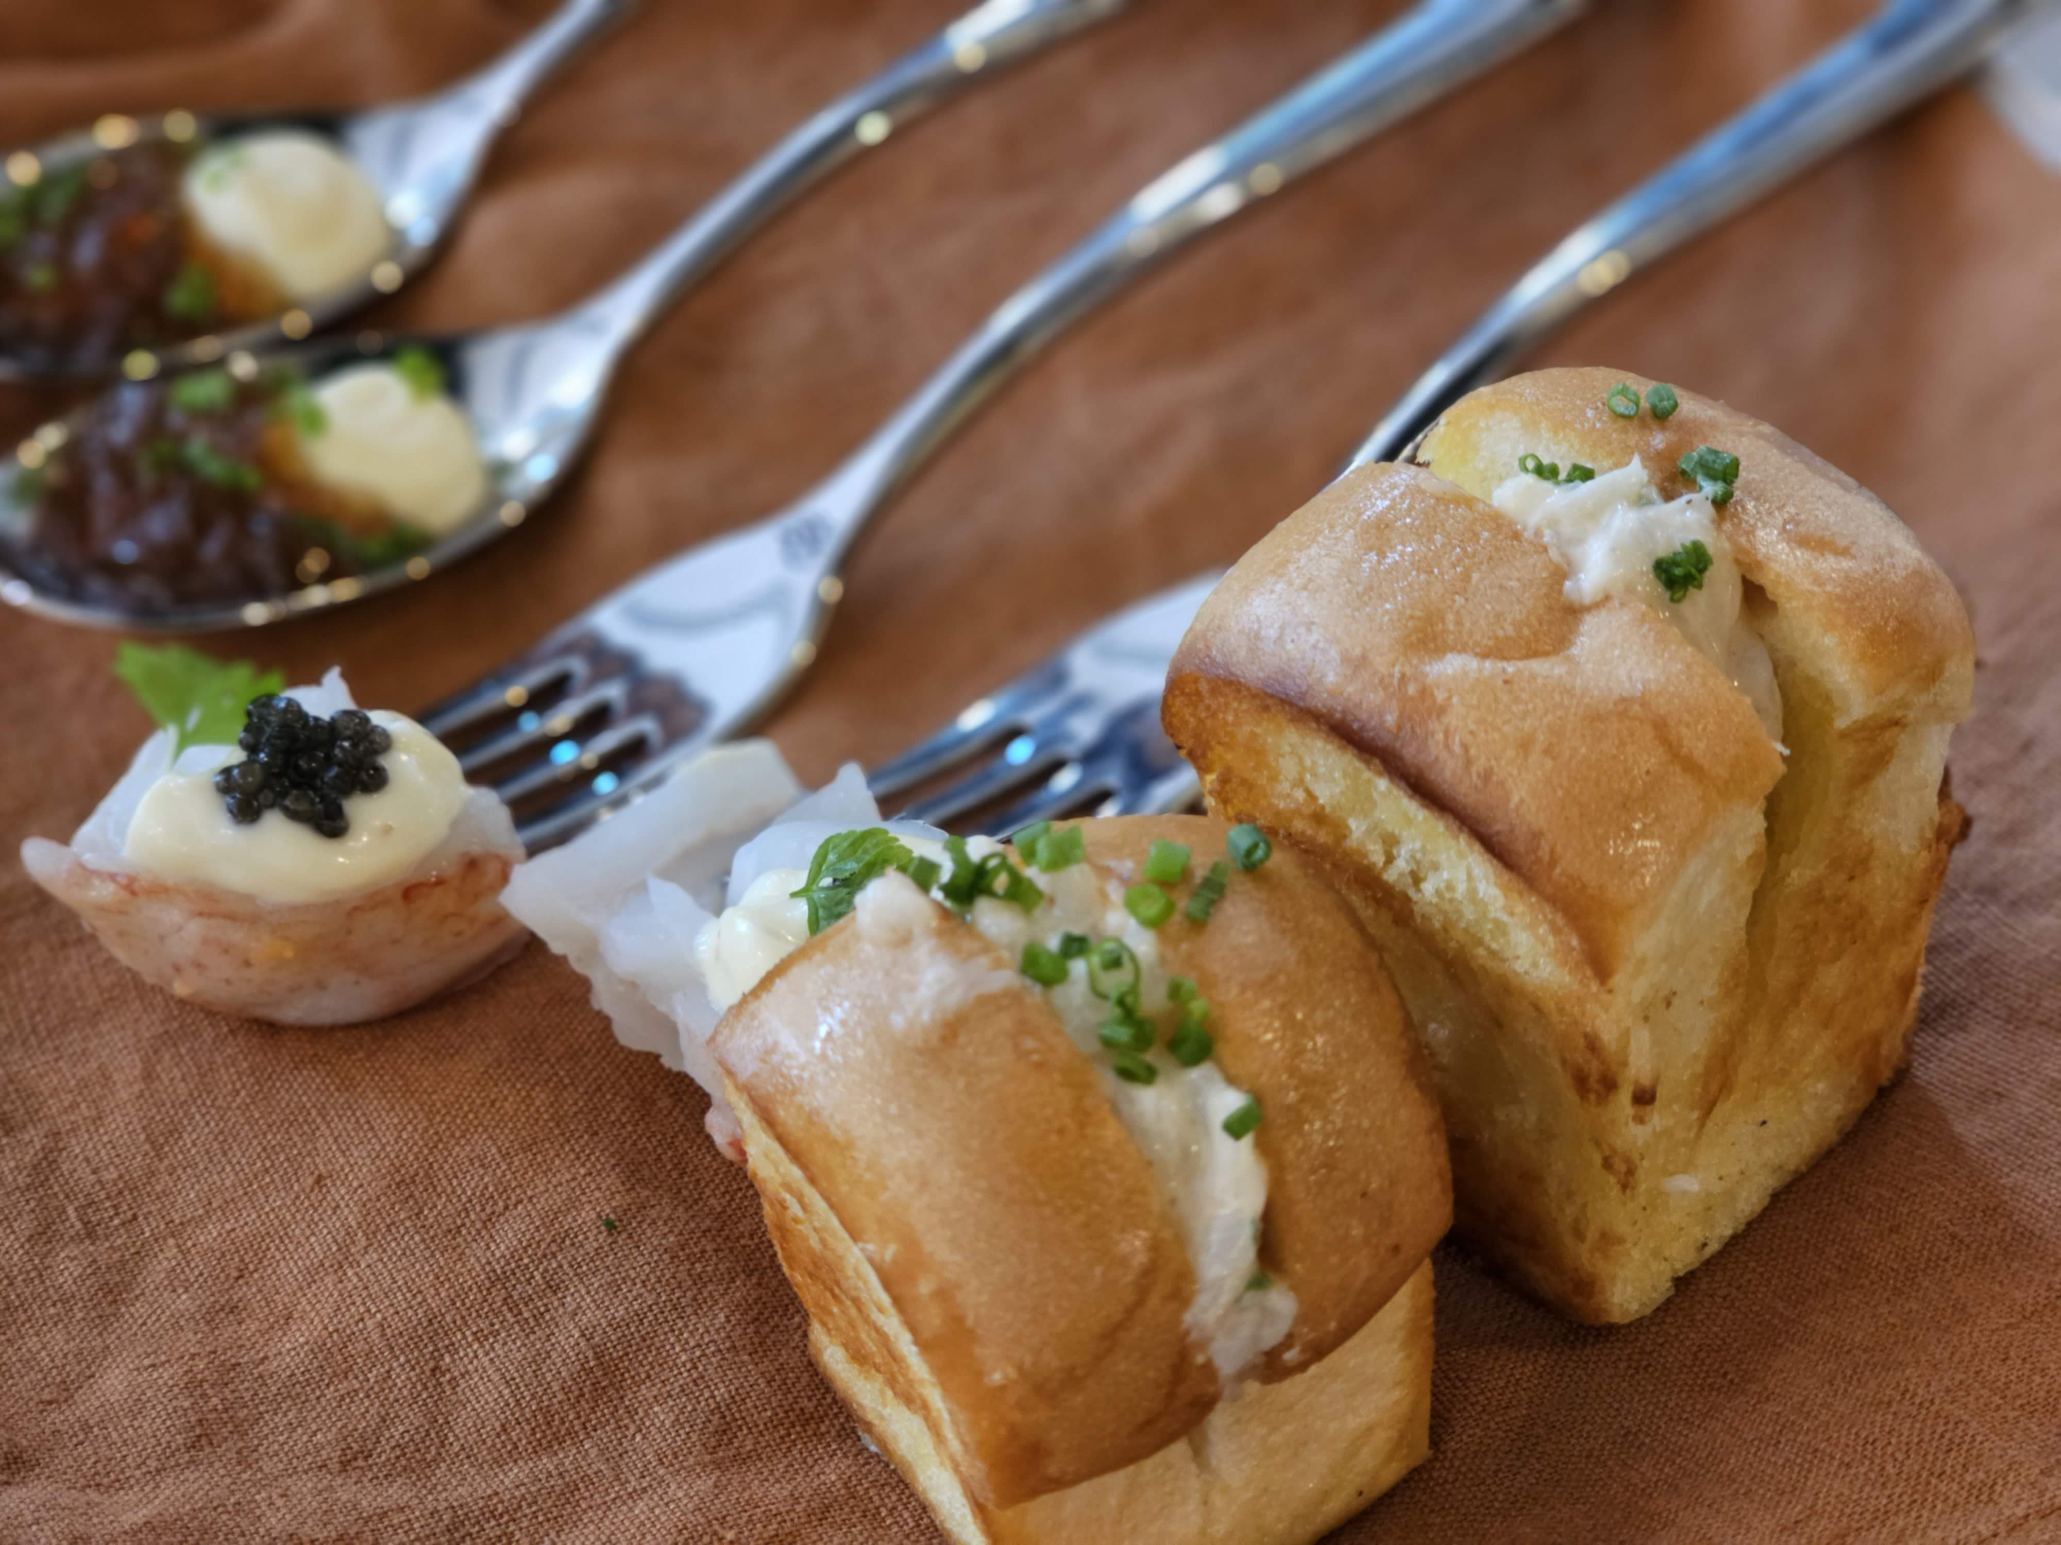
Do something really different to your normal menu

Slide 13
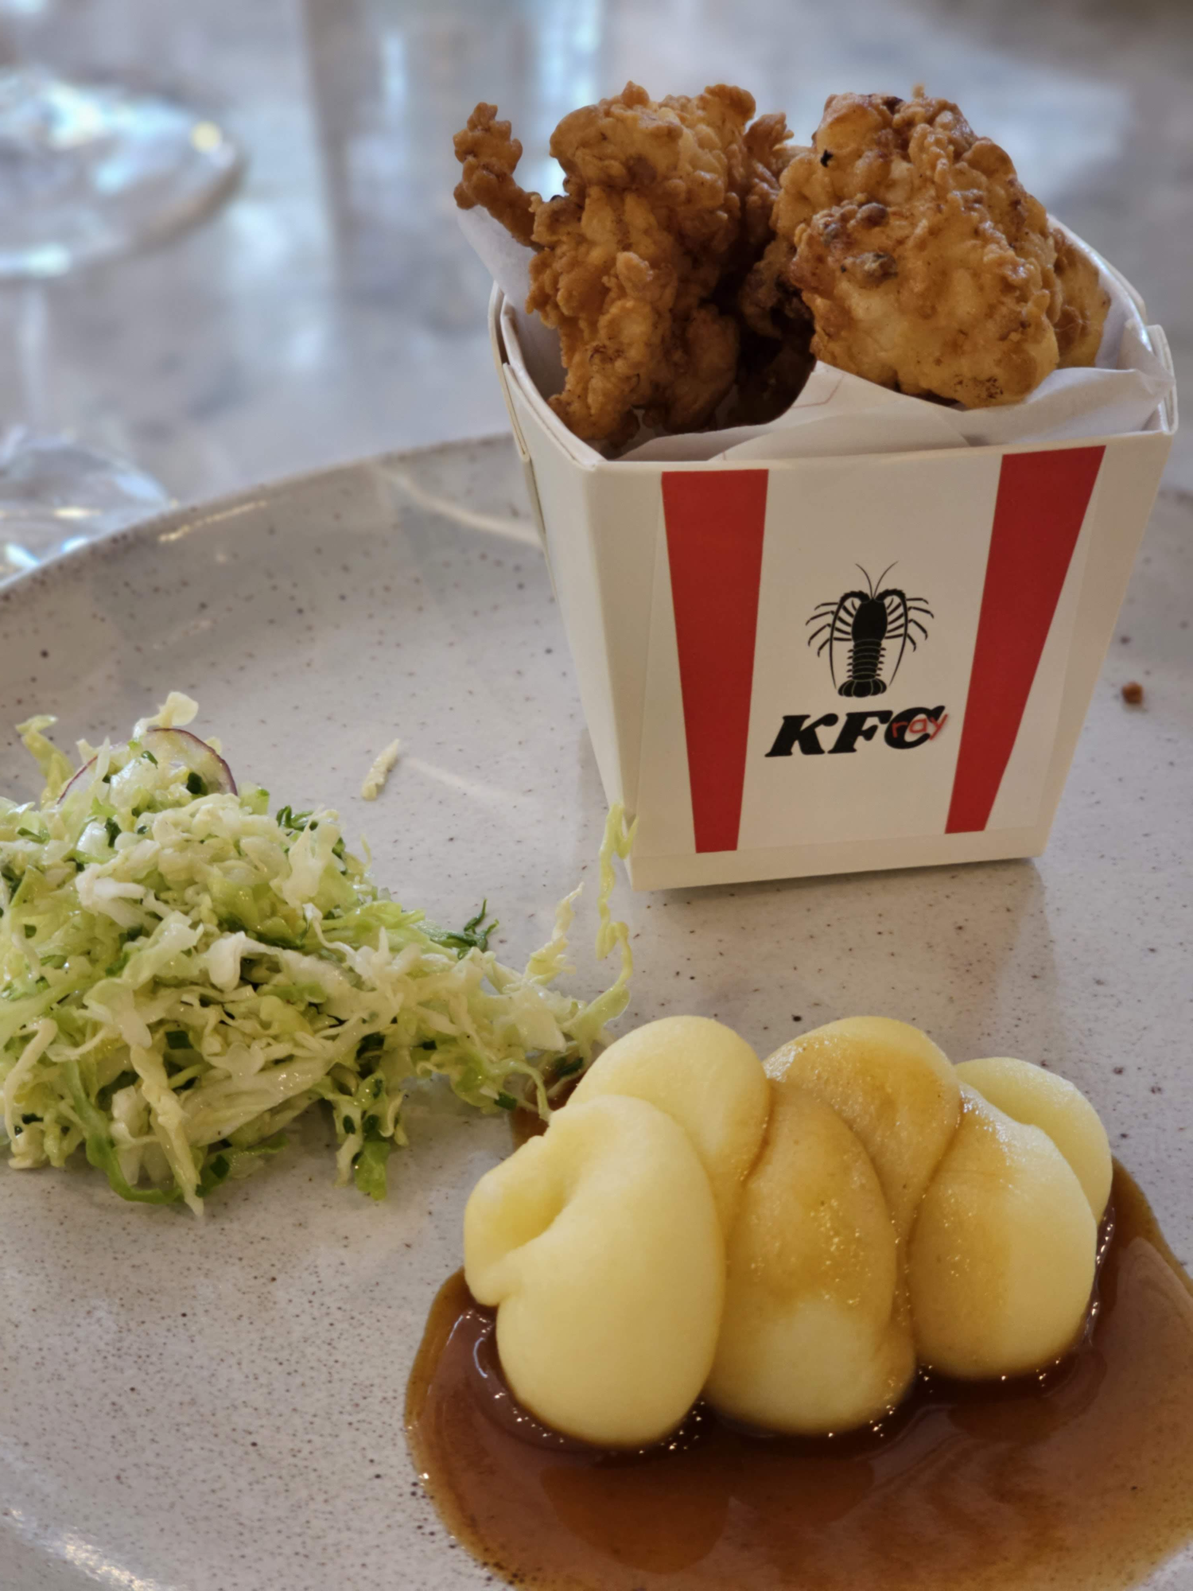
Do menu

Slide 14
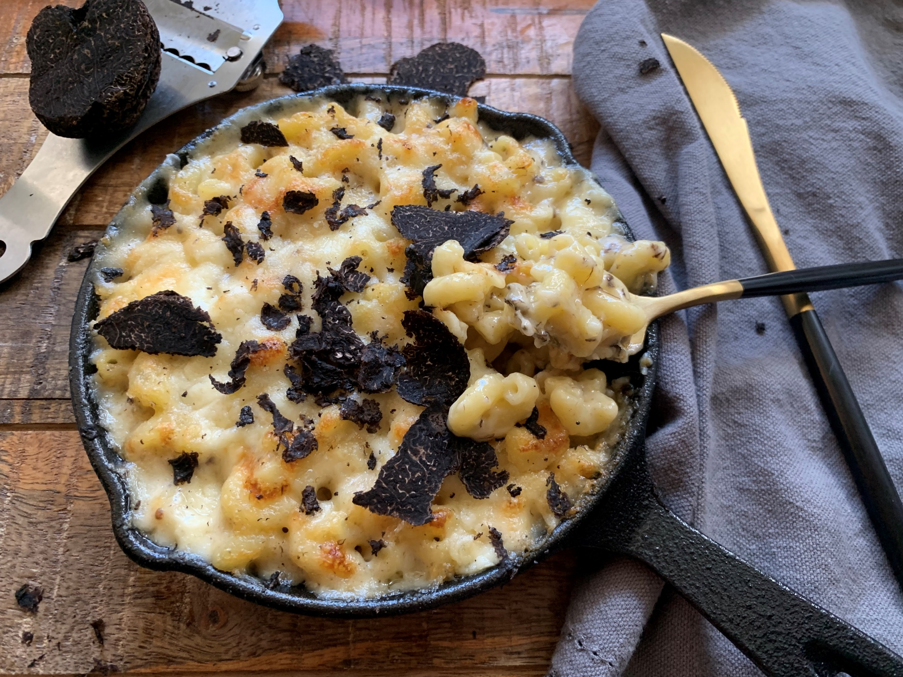
Flip your style – if you’re usually fine dining do a great Mac n Cheese or hot dog
Indigenous Ingredients
Nostalgia - a dish you don’t see any more/ a dish from a previous owner that everyone loved/ a dish from CO history/ retro 70s or 80s food
A totally different cuisine – Indian, Korean, Swedish (something inspired by a staff member?)
Mash up – eg Gochu’s Milk Buns
Street food from your travels
Created by your regulars – people’s choice (using AI?) or social media suggestions/votes
Rescued/no waste
Change it up

Slide 15
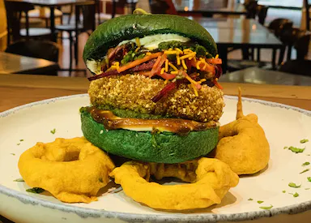
50
Examples
40
Flavours of Plenty
Burger Wellington
30
20
10
0
Item 1
Item 2
Item 3
Item 4
Item 5

Slide 16
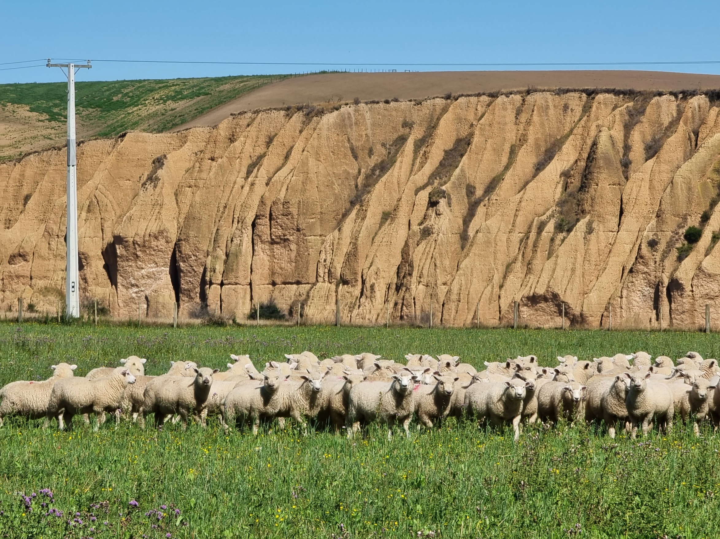
Dish
descriptions
  Add adjectives for texture, taste, smell
  Tell the story
  Describe provenance of ingredients
  Highlight anything made in house
  How are the ingredients made, raised, grown

Slide 17
Have a Go
  Example:
  Pulled pork burger
  Slow cooked, hand-pulled juicy pork slathered in Chef Sam's homemade sauce and topped with a fresh citrusy slaw
  Lamb Shank with chimichurri, sauteed potatoes and seasonal greens
  Beef burger with lettuce tomato, local apricot kasundi, local cheese
  Lamb rump with gnocchi and salad
  Brisket, Jalapeño, cheese pie

